Slide 1



The Case for CC
Jessica Coates
Project Manager
Creative Commons Clinic
AUSTRALIA
part of the Creative Commons international initiative
CRICOS No. 00213J
Notes:
I’ve been asked to provide the basic case for CC
So first of all – to make sure we’re all up to speed – what is CC?

Slide 2


Some rights reserved
AUSTRALIA
part of the Creative Commons international initiative
CRICOS No. 00213J
Notes:
Voluntary licensing system that aims to make copyright material more usable in the digital environment
Does this by providing a suite of licences that creators can apply to their material to give permission in advance for certain uses
The creators retain full copyright in their work but basically say to users ‘you can use my material in these ways, as long as you obey these rules’
the licences are designed:
To be flexible;
To be easy to use and understand; and
To apply in the same way anywhere in the world.
Essentially, Creative Commons provides a more open alternative to the standard ‘all rights reserved’ approach – ‘some rights reserved’

Slide 3




Attribution
Noncommercial
No Derivative Works
ShareAlike
AUSTRALIA
part of the Creative Commons international initiative
CRICOS No. 00213J
Notes:
The CC licences are all based on the same four basic building blocks
These each represent how creators might want restrict how others can use their work

Slide 4
AUSTRALIA
part of the Creative Commons international initiative
CRICOS No. 00213J
Notes:
Users can mix and match these elements to create six ‘core’ licences, each of which provides a different level of freedom for their work
So, for example, an author may be happy to allow private uses of their work, but may want to limit how it can be used commercially.
They may also want people to remix their work, but only so long as that person attributes them and makes the new work available for others to remix
So they can choose the Attribution-noncommercial-sharealike licence

Slide 5

AUSTRALIA
part of the Creative Commons international initiative
CRICOS No. 00213J
Notes:
CC licences are not:
Anti-copyright – just another rights management tool for creators
Anti-commercial – can charge for first use, commercial uses, “gold” service, or embed advertising
Right for every situation – look carefully at what you want

Slide 6

AUSTRALIA
part of the Creative Commons international initiative
CRICOS No. 00213J
Notes:
CC licences are not:
Anti-copyright – just another rights management tool for creators
Anti-commercial – can charge for first use, commercial uses, “gold” service, or embed advertising
Right for every situation – look carefully at what you want

Slide 7

AUSTRALIA
part of the Creative Commons international initiative
CRICOS No. 00213J
Notes:
CC licences are not:
Anti-copyright – just another rights management tool for creators
Anti-commercial – can charge for first use, commercial uses, “gold” service, or embed advertising
Right for every situation – look carefully at what you want

Slide 8
AUSTRALIA
part of the Creative Commons international initiative
CRICOS No. 00213J
Notes:
CC licences are not:
Anti-copyright – just another rights management tool for creators
Anti-commercial – can charge for first use, commercial uses, “gold” service, or embed advertising
Right for every situation – look carefully at what you want

Slide 9
?
AUSTRALIA
part of the Creative Commons international initiative
CRICOS No. 00213J
Notes:
So why would you use CC?
The automatic assumption, particularly among professional creators, is that full copyright protection is always the best and only option
But there is a real question whether this is true in the digital environment
The internet can be a powerful marketing, promotion and distribution tool
But all rights reserved copyright can act as a severe damper on this
Under full copyright people can’t print out your work, they can’t email it to people, they can’t place extracts on their blog – or at least, its hard to know exactly when this will be allowed
So if you want to take full advantage of the potential of the internet, the best approach is to place a licence on your work – one that lets people know exactly how you are and are not happy for them to do
When you’re deciding how best to distribute your book, controlling copying shouldn’t be your major concern – arguably marketing, profile raising, getting it out there is more important

Slide 10
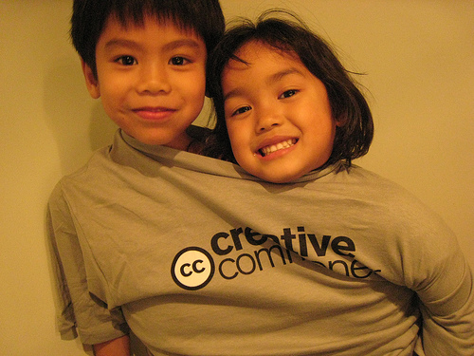
Photo © cambodia4kidsorg, http://www.flickr.com/photos/cambodia4kidsorg/312407445/in/pool-83508397@N00
CC BY licence (http://creativecommons.org/licenses/by/2.0/deed.en)
AUSTRALIA
part of the Creative Commons international initiative
CRICOS No. 00213J
Notes:
Some of the benefits of using CC licensing rather than writing your own are:
Built in metadata – searching via google
Legal certainty – hundreds of lawyers have looked at them
Recognition – more and more people recognise and understand the CC concept
The main argument here is not that you should always use CC, but that you shouldn’t be afraid of using CC
For the time being at least, there is no sign that e-books are going to take over from hard copies
People still want to read from the page, and printing long works out isn’t a viable option
It’s also important to remember that it doesn’t have to be an all or nothing option - you don’t have to just release your entire book under CC
To test the waters, you might want to release:
part of the work – eg a single chapter, or a few poems
Products that you have already been paid for, or don’t expect to be paid for – eg articles for journals, blogs, opinion pieces
products that are part their commercial lifespan – eg books that are out of print – perhaps in conjunction with a print on demand option

Slide 11
http://www.creativecommons.org
http://www.creativecommons.org.au
This slide show is licensed under a Creative Commons Australia Attribution licence. For more information see http://creativecommons.org/licenses/by/2.5/au/.
AUSTRALIA
part of the Creative Commons international initiative
CRICOS No. 00213J

